Slide 1

Target Non-Brand CPA
£50
Restructure & Growth Plan
Down from £64 — 22% reduction within 90 days via PMax → Search migration
+29%
90 Days
£12,000/mo
Dental by Design | Prodent Group
More Leads (Same Budget)
PMax → Search Migration
Potential Monthly Saving
Christopher Hoole
Google Ads Specialist | April 2026
christopherhoole.com
Based on data: 2025 + 2026 + PMax 30-day deep dive

Slide 2
Executive Summary
Restructure Plan
£50
+236/mo
PMax→Search
£53,990
Target Non-Brand CPA
Additional Leads (Same Budget)
Core Strategy Change
Current Monthly Spend
The Plan
Week 1: Fix conversion tracking (remove 1,511 KMG ghosts + soft signals), block NHS/free seekers from PMax, add Display exclusions, negative keyword 9-list overhaul.
Weeks 2-3: Build new treatment-specific Search campaigns (Single Implants, Full Arch, Financing, Invisalign) with proper ad copy, negatives, and tCPA bidding.
Week 4: Launch new Search campaigns. Shift 30% of PMax budget. Monitor and compare real booking rates.
Month 2: Scale Search winners based on data. Continue reducing PMax budget. Geo restructure (radius → postcodes). Device + schedule bid adjustments.
Month 3: Search becomes dominant. PMax reduced to supplementary role (brand awareness only). Multi-clinic rollout planning.
The PMax deep-dive revealed the “low CPA” is an illusion — real booking CPA is £418. The Financing ad group already proves Search can deliver £34 CPA at 24.7% CVR. The data supports this migration.
Christopher Hoole | christopherhoole.com | Confidential
2

Slide 3
Why PMax → Search
Strategic Decision
The data from Reports 1 and 2 makes the case for migrating to structured Search campaigns
PMax: The Problems (Last 30 Days)
Search: The Opportunity
• 81.7% of spend is Google Search anyway — PMax isn't adding multi-channel value • Display burns £1,893/month on mobile games (Block Blast, Colour by Number) for 2 conversions • Top converting terms are NHS/free seekers who never become patients • Real booking CPA: £418 (only 72 bookings from £30,026) • Only 93 negative keywords — vs 2,192 across the account • CPA doubled from £26 (2025) to £65 (last 30 days) as it scaled • Single asset group — no treatment segmentation
• The Financing ad group already delivers £34 CPA at 24.7% CVR — proof that well-structured Search works • Full control over keywords, match types, and negative keywords • Full visibility into every search term — no hidden waste • Treatment-specific ad copy matched to specific search intent • Device, schedule, and geo bid adjustments at campaign level • Route traffic to the right landing page per keyword intent • tCPA bidding gives direct control over cost per lead • Structured campaigns scale naturally to partner clinics
Christopher Hoole | christopherhoole.com | Confidential
3

Slide 4
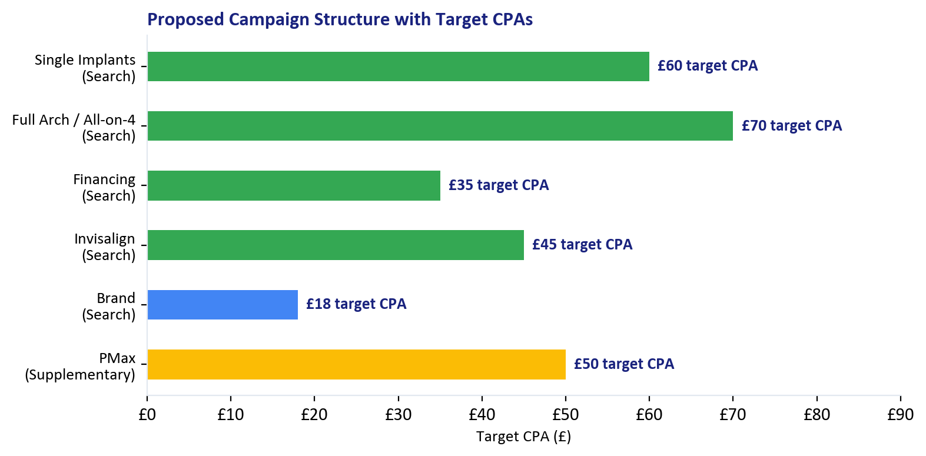
Proposed Campaign Structure
New Structure
Treatment-specific Search campaigns with tCPA bidding
Campaign | Target CPA | Landing Page | Basis
Single Implants | £60 | /dental-implants-offer | Best LP at £34 CPA
Full Arch / All-on-4 | £70 | /all-on-4-offer | High value, higher CPA expected
Financing | £35 | /dental-implants-offer | Proven: £34 CPA, 24.7% CVR
Invisalign | £45 | /invisalign | Currently £45 CPA
Brand | £18 | (homepage) | Currently £18 — no change
PMax (reduced) | £50 | Various | Supplementary only
Each campaign gets proper negative keywords, treatment-specific ads, matched landing pages, and tCPA bidding. This is what PMax can't do.
Target CPAs are conservative starting points. The Financing ad group at £34 CPA proves these targets are achievable with the right structure.
Christopher Hoole | christopherhoole.com | Confidential
4

Slide 5
Step 1: Fix Conversion Tracking
Week 1
Remove ghosts, move soft signals, replace arbitrary ROAS values
Conversion Action | Current | Proposed | Why
KMG OLD LP | Book A Free Consult | Primary | Remove | Ghost — 1,250 phantom conversions (Giulio confirmed)
KMG OLD LP | Website Phone Call | Primary | Remove | Ghost — 57 phantom conversions
KMG | Call Extension | Primary | Remove | Legacy agency — 204 phantom conversions
Online Booking Click | Primary | Secondary | Click, not a booking — 264 soft signals
Phone Click / WhatsApp Click / Chat | Primary | Secondary | Clicks, not actions — 181 soft signals
Dengro Offline Booking | Primary (L300) | Keep (real value) | Replace L300 with actual treatment value
Dengro Offline Lead | Primary | Keep (verify) | Verify only ad-sourced leads are counted
Calls from the ads | Primary | Keep | Real calls — 965 legitimate conversions
Bid Strategy Recommendation
ROAS Alternative (If Preferred)
Switch from Target ROAS to Target CPA on all Search campaigns. PMax: Start tCPA at £50 Search Intent: Start tCPA at £65, reduce to £50 over 8 weeks New campaigns: tCPA per treatment type (see slide 4) Target CPA gives direct control over cost per lead. The arbitrary £300 ROAS values have been misleading the algorithm.
If Tommaso prefers ROAS, replace arbitrary £300 with actual treatment revenue: • Single implant booking: £1,695 • All-on-4 booking: £9,995 • Vivo Bridge booking: £15,990 This lets the algorithm bid more for high-value treatments. Requires reliable Dengro attribution.
Christopher Hoole | christopherhoole.com | Confidential
5

Slide 6
Step 2: Negative Keyword Overhaul
Week 1
9-list system + immediate NHS/free/Display blocks for PMax
Immediate PMax Blocks (Day 1)
9-List Negative Keyword System
Add account-level exact match negatives for: • [how to apply for dental implants on the nhs] (31 junk conversions/month) • [free dental implants near me] (30 junk conversions/month) • [how to get free dental implants on nhs] (14 junk conversions/month) • All 'nhs', 'free implant', 'clinical trial' variations These are PMax's top converting terms but they generate zero bookings.
Replace 784 broad match negatives with structured lists: • 1 word — phrase + exact • 2 words — phrase + exact • 3 words — phrase + exact • 4 words — exact only • 5+ words — exact only No broad match. Weekly search term reviews.
Priority Negative Keyword Categories (Both Years Data)
Category | Examples | 2025 Waste | 2026 Waste | Match Type | Priority
NHS / Free seekers | nhs dental implants, free implants, clinical trials | £1,378 | £706 + junk conv | Phrase + Exact | Immediate
Price Research (no location) | implant cost uk, how much is dental implants | £20,540 | £14,211 | Phrase | Week 1
Wrong Treatment | implant dentures, dental bridge, dental crown | £3,112 | £3,661 | Phrase | Week 1
Competitor / Tourism | brighton implant clinic, turkey teeth | £1,724 | £1,390 | Exact | Week 1
Also: Add Display placement exclusions to PMax — remove mobile game apps, puzzle games, and irrelevant sites. This stops the £1,893/month Display waste immediately.
Christopher Hoole | christopherhoole.com | Confidential
6

Slide 7
Step 3: Ad Copy Rewrite
Weeks 2-3
90% of ads rated Poor/Average — the #1 lever for reducing CPA
Proposed Ad Testing Framework (New Search Campaigns)
Campaign | Angle 1 (Price) | Angle 2 (Speed) | Angle 3 (Quality) | Landing Page
Single Implants | From £1,695. 0% Finance Available. | Permanent Teeth in 48 Hours. | 4.8★ Rating. 399+ Reviews. | /dental-implants-offer
Full Arch / All-on-4 | Full Arch From £9,995. | New Teeth in 48 Hours. Walk Out Smiling. | CQC Registered. Expert Surgeons. | /all-on-4-offer
Financing | 0% Finance. From £47/month. | Book Free Consultation Today. | Trusted by 399+ Patients. | /dental-implants-offer
Invisalign | Invisalign From £2,500. | Free Scan. Results in 6 Months. | Diamond Apex Provider. | /invisalign
Testing Plan
Expected Impact
2-3 RSA variants per ad group, each testing a different messaging angle. Run for 4-6 weeks, then keep winner and test new challenger. Every headline must match the keyword intent in that ad group. This is what the current ads fail to do — 71% of keywords have Below Average ad relevance. Key USPs to leverage: “up to 60% less”, Vivo Bridge 48 hours, 4.8★ / 399+ reviews, 0% finance.
Improving ad relevance from Below Average to Average on the top 20 keywords would lift QS by 2-3 points. At QS 7 vs QS 3, CPC drops by an estimated 30-50%. On £53,990/month spend, that’s £16-27K/month in CPC savings. Combined with the Financing ad group’s proven £34 CPA, well-written treatment-specific ads should bring the Search campaign CPA below £60.
Christopher Hoole | christopherhoole.com | Confidential
7

Slide 8
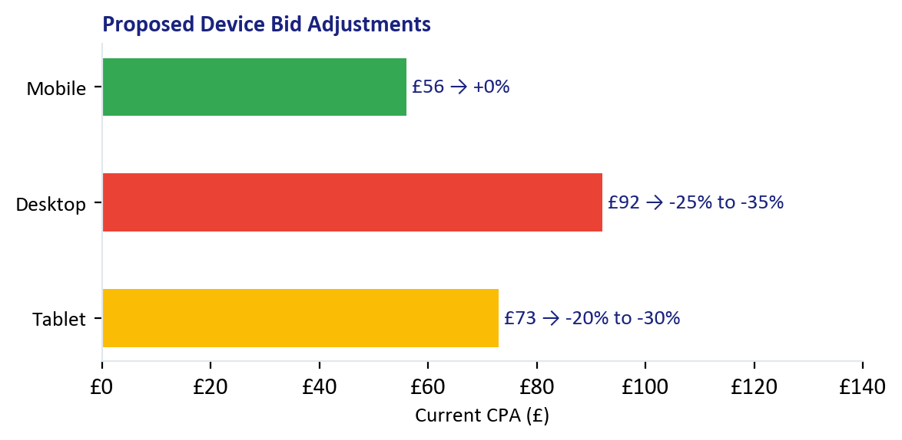
Step 4: Bid Adjustments
Weeks 2-4
Device, schedule, day-of-week — no adjustments currently exist
Day of Week (2026 Data)
Day | 2025 CPA | 2026 CPA | Proposed
Monday | £41 | £64 | -5%
Thursday | £44 | £58 | +5%
Friday | £46 | £56 | +10%
Saturday | £43 | £56 | +10%
Sunday | £45 | £68 | -15%
Hour of Day
Geo: Radius → Postcodes
Increase bids +10-15%: Hours 16-17 (4-5pm): £46-48 CPA both years. High-volume, efficient. Reduce bids -15-20%: Hours 7-8 (7-8am): £56-74 CPA. Expensive commute clicks. These adjustments apply to Search campaigns. PMax handles its own scheduling.
Replace radius targeting with London postcodes: • Bid +20% for W6, W12, W3 (near clinic, £28-53 CPA) • No change for mid-range postcodes • Bid -20% for N13 £169, TW2 £137, WD23 £123 All campaigns share the same postcode targets. Unified geographic view across the account.
Christopher Hoole | christopherhoole.com | Confidential
8

Slide 9
Multi-Clinic Growth
Month 3+
The optimised Dental by Design structure becomes the blueprint for partner clinics
Dental by Design
Partner Clinics
Flagship — Testing Ground
UK Network — Scaled Learnings
Treatment-specific Search campaigns (proven model)
Establish CPA benchmarks per treatment type
Test ad copy angles — winning angles become the playbook
Postcode-level geo data informs partner clinic targeting
▶
Same campaign structure — localised per clinic
Shared negative keyword lists (9-list system)
Performance-based budgets — best clinics earn more spend
Postcode targeting per clinic location
What Scales from Flagship to Network
9-List
Ad Copy
tCPA
Reporting
Postcodes
Neg Keyword Framework
Winning Angles
Benchmarks per Treatment
Monthly Framework
Geo Structure
Christopher Hoole | christopherhoole.com | Confidential
9

Slide 10
Projected Results
90-Day Target
Conservative projections based on Reports 1, 2, and PMax deep-dive
£64→£50
+236/mo
£12K/mo
£418→?
Non-Brand CPA Target
Additional Leads (Same Budget)
Potential Monthly Saving
Real Booking CPA (Improve)
Scenario 1: More Leads, Same Spend
Scenario 2: Same Leads, Less Spend
Keep spend at £53,990/month. Reduce non-brand CPA from £64 to £50. Result: ~236 additional patient leads per month (+29%). More importantly: these will be QUALIFIED leads (not NHS/free seekers) because the Search campaigns target paying patients specifically.
Maintain current lead volume. Reduce CPA from £64 to £50. Result: £12,000/month saving (£144K/year). The savings come from eliminating Display waste, blocking junk leads, and better keyword targeting.
Why These Projections Are Achievable
• The Financing ad group already delivers £34 CPA at 24.7% CVR — with proper structure, other ad groups can approach this • 2025 non-brand CPA was £46 — the account has achieved below £50 before • £1,893/month in Display waste is immediately recoverable • Blocking NHS/free seekers stops the algorithm chasing junk conversions • Ad rewrites improving QS from 3 to 7 reduces CPCs by an estimated 30-50%
Christopher Hoole | christopherhoole.com | Confidential
10

Slide 11
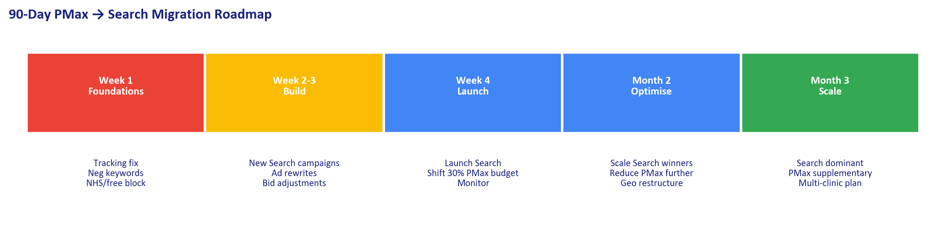
Implementation Timeline
90-Day Roadmap
Week 1
Weeks 2-3
Week 4 + Month 2
Month 3
Fix Foundations
Build + Rewrite
Launch + Optimise
Scale
Remove KMG ghost conversions
Move soft signals to Secondary
Block NHS/free seekers (account-level)
Add PMax Display exclusions
Negative keyword 9-list overhaul
Disable auto-apply
Build 4 new Search campaigns
Write treatment-specific RSAs
Set tCPA targets per campaign
Implement device bid adjustments
Implement schedule adjustments
Launch Search campaigns
Shift 30% of PMax budget
Monitor real booking rates
Geo: radius → postcodes
Scale Search winners
Search becomes dominant
PMax → supplementary only
Per-treatment benchmarks
Multi-clinic planning
Full reporting framework
Christopher Hoole | christopherhoole.com | Confidential
11

Slide 12
Ready to Start Immediately
Christopher Hoole
Next Steps
chris@christopherhoole.com
christopherhoole.com
+44 7999 500 184
1
Grant me editor access to the account
I can implement the Week 1 fixes in a single session
Conversion tracking + negative keyword overhaul in Week 1
£50
PMax→Search
+29%
2
The two highest-impact changes — immediate CPA improvement
Target CPA
90-Day Migration
More Leads
3
New Search campaigns built and launched by end of Month 1
Treatment-specific structure with proper ads, negatives, tCPA
“The data is clear. PMax is attracting the wrong patients and wasting budget on mobile games. Structured Search campaigns with proper targeting will deliver more real patient bookings for the same budget. I’m ready to implement Week 1 the day I start.” — Christopher Hoole
4
Monthly reporting from Day 1
Full transparency on what changed, why, and the measured impact

